Slide 1
Enterprise Creation and Data Management
Aldrich Tambajong

Slide 2
Enterprise Structure
Will be based off a restaurant structure
6 Departments
Human Resources
Operations
Financing
Training and Development
Claims
Information Technology

Slide 3
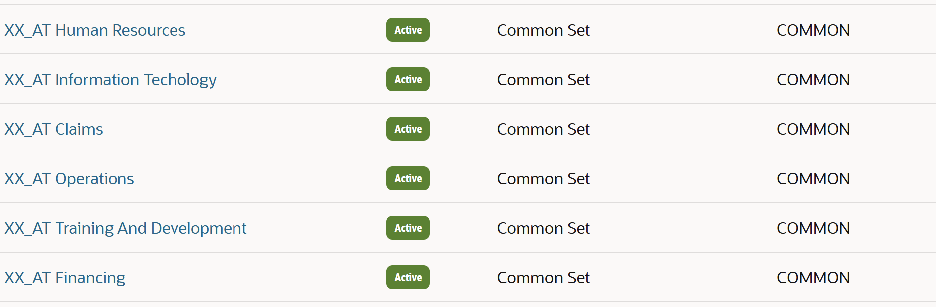
Step1: Defining the Enterprise
First step: Creating Departments
Departments needed first to determine which positions/jobs would be necessary for the enterprise
Necessary Departments:
Operations – Responsible for day-to-day restaurant activities and supervision of all restaurants in region
Human Resources – Variety of responsibilities from training/recruiting employees, employee data management, dealing with grievances, etc.
Finance– Responsible for employee payroll and organization’s finances
IT – Resolves tech issues and aims to improve organization’s tech structure
In addition, business units and locations must be established for the enterprise

Slide 4
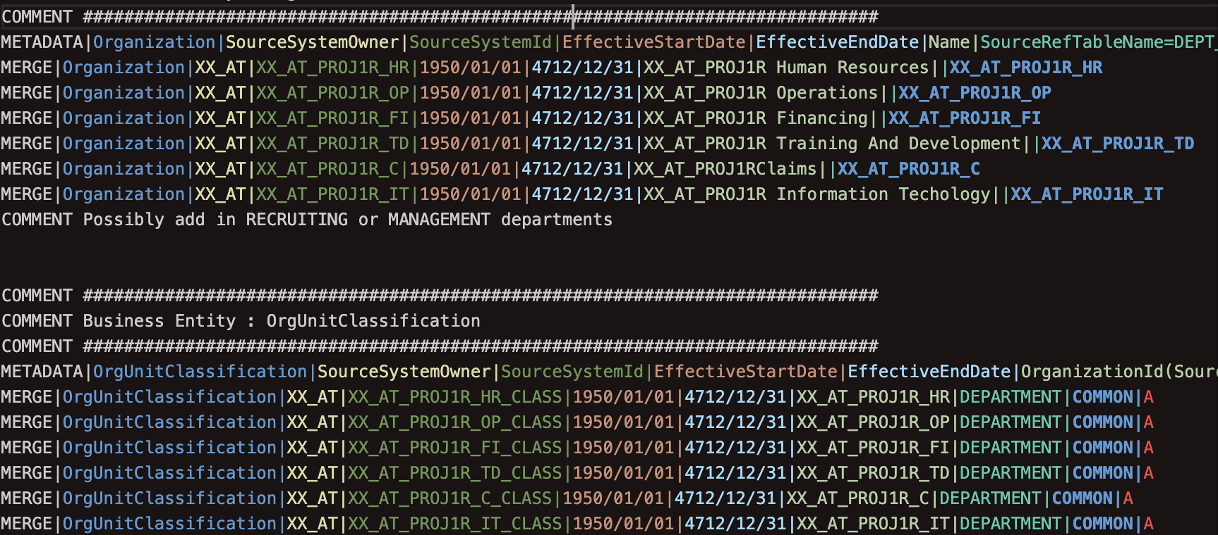

Slide 5
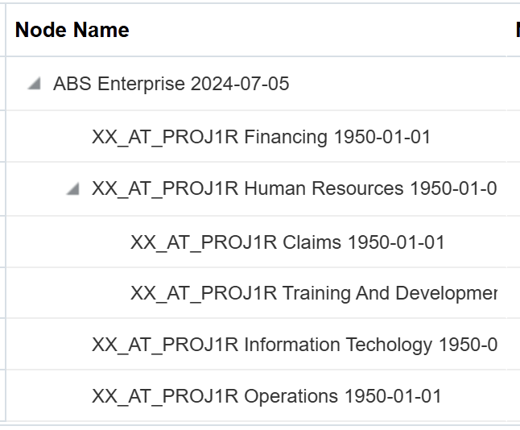
Step 1: Defining the Enterprise
Second step: Establishing the structure
Once departments are created, a tree structure is created to establish hierarchy
Complexity can vary based on the organization and their finances

Slide 6
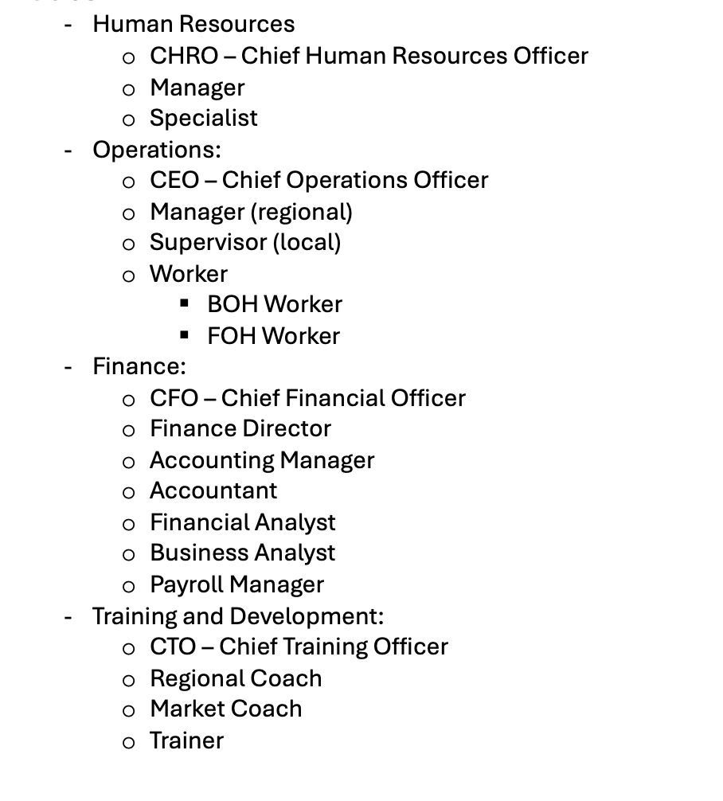
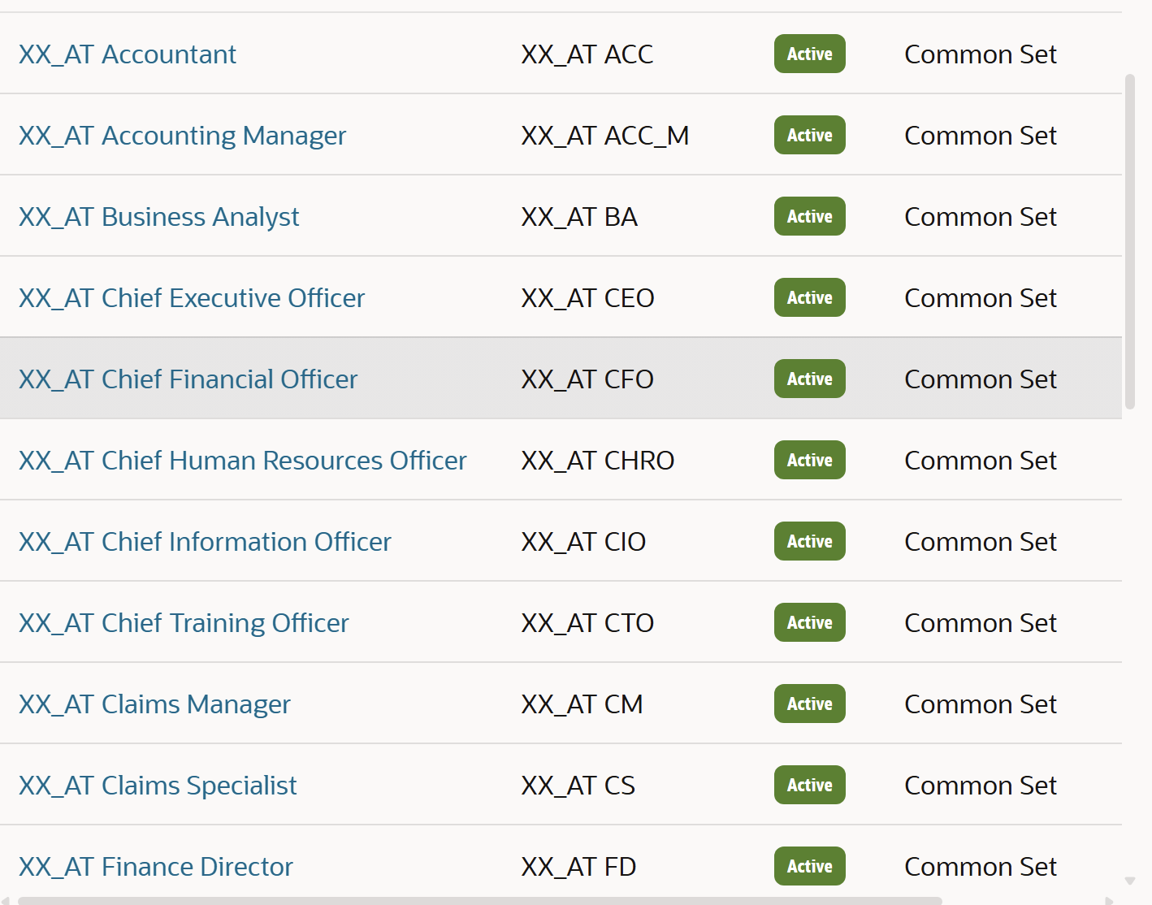
Step 1: Defining the Enterprise
Third step: Creating Jobs/Positions for departments
Structure needed to be established first to determine relevant jobs; would be more difficult other way around
Restaurants need kitchen and dining room employees, someone to manage them, someone the managers need to report to and so on

Slide 7
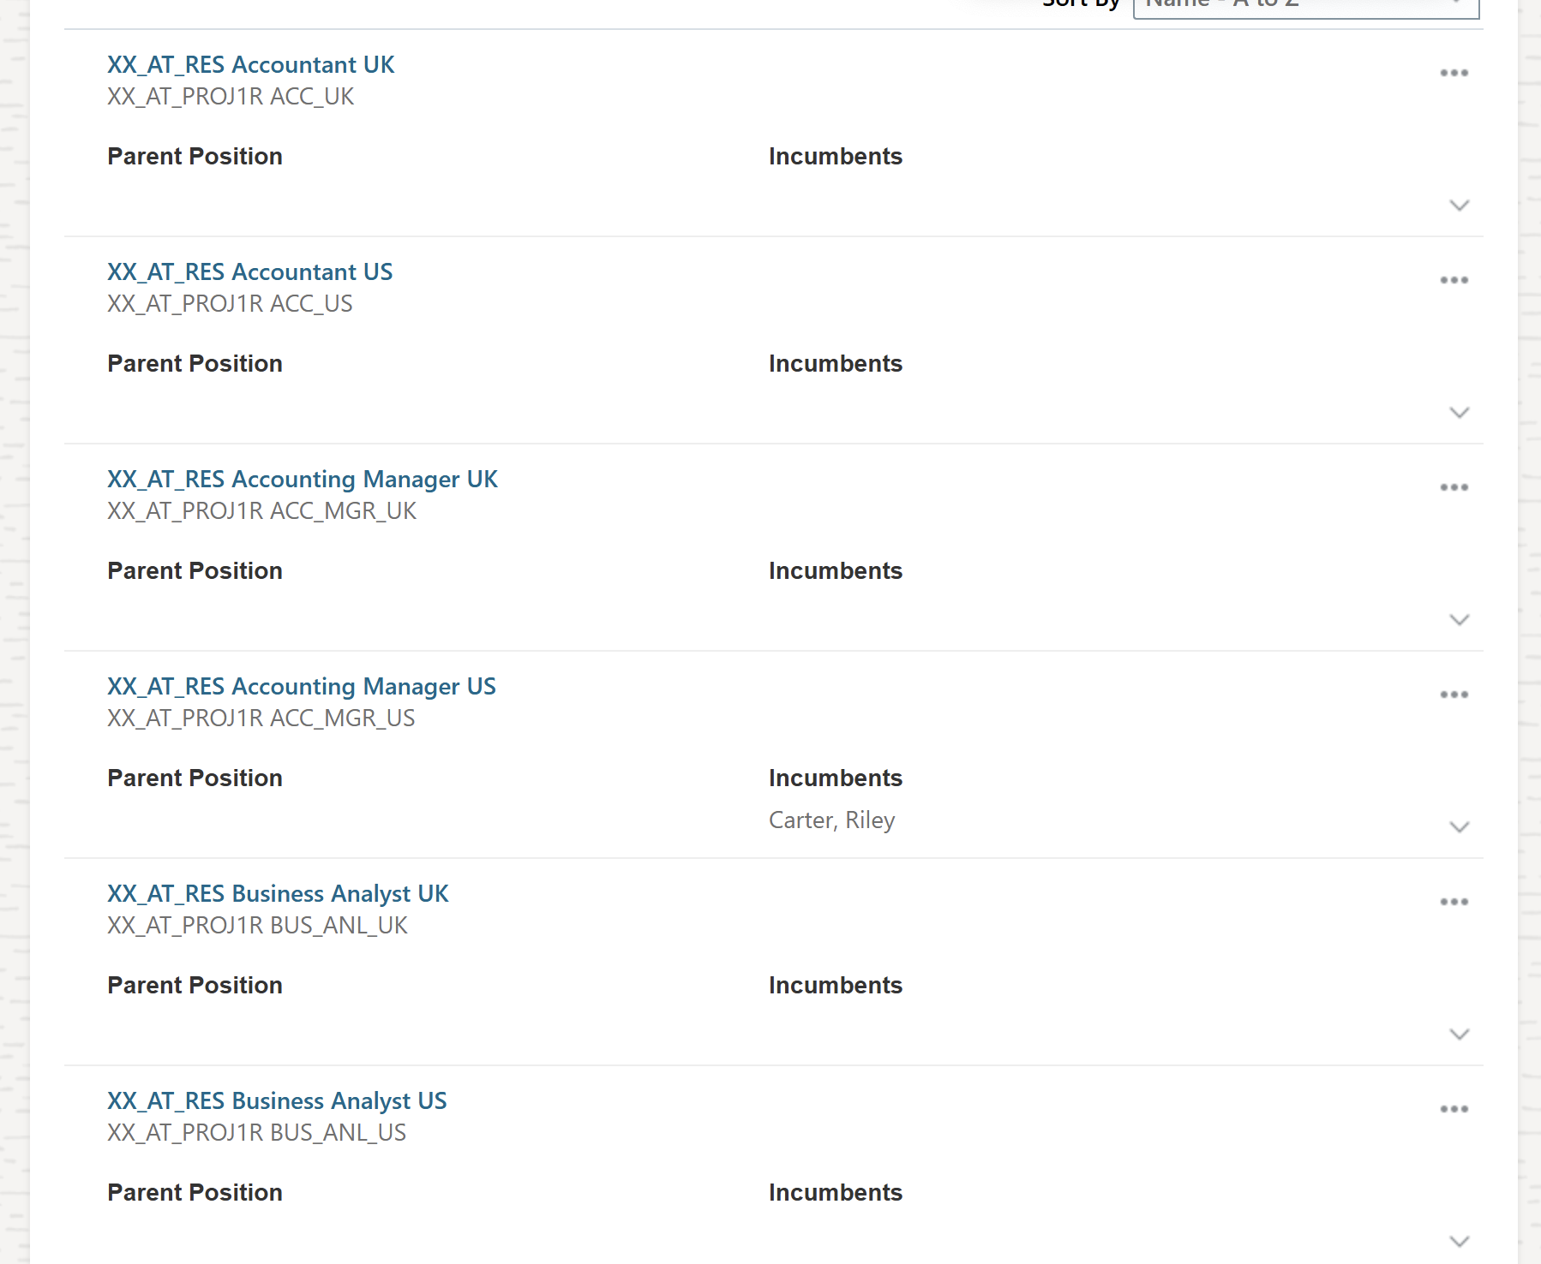
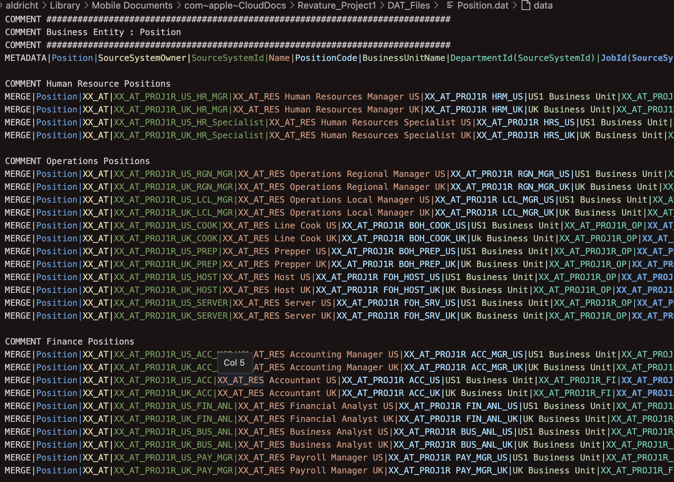

Slide 8
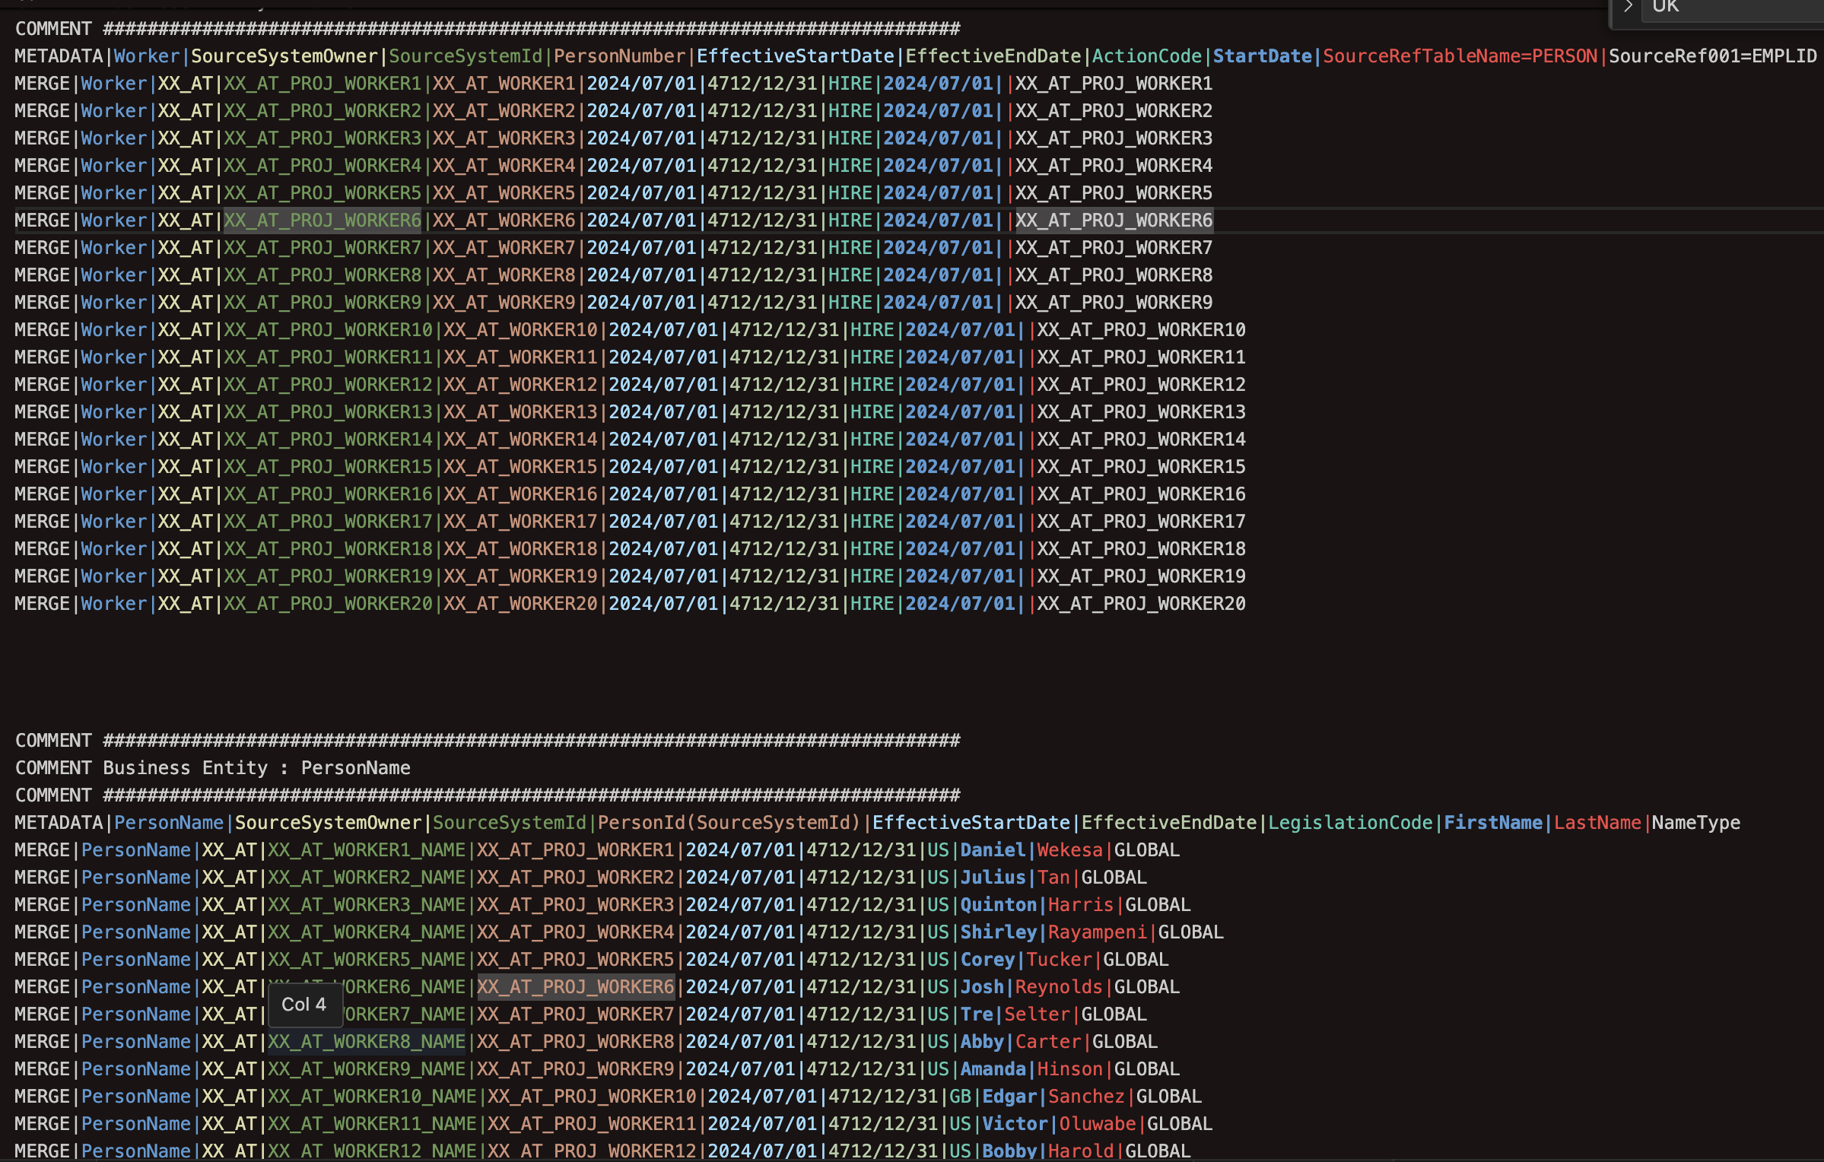
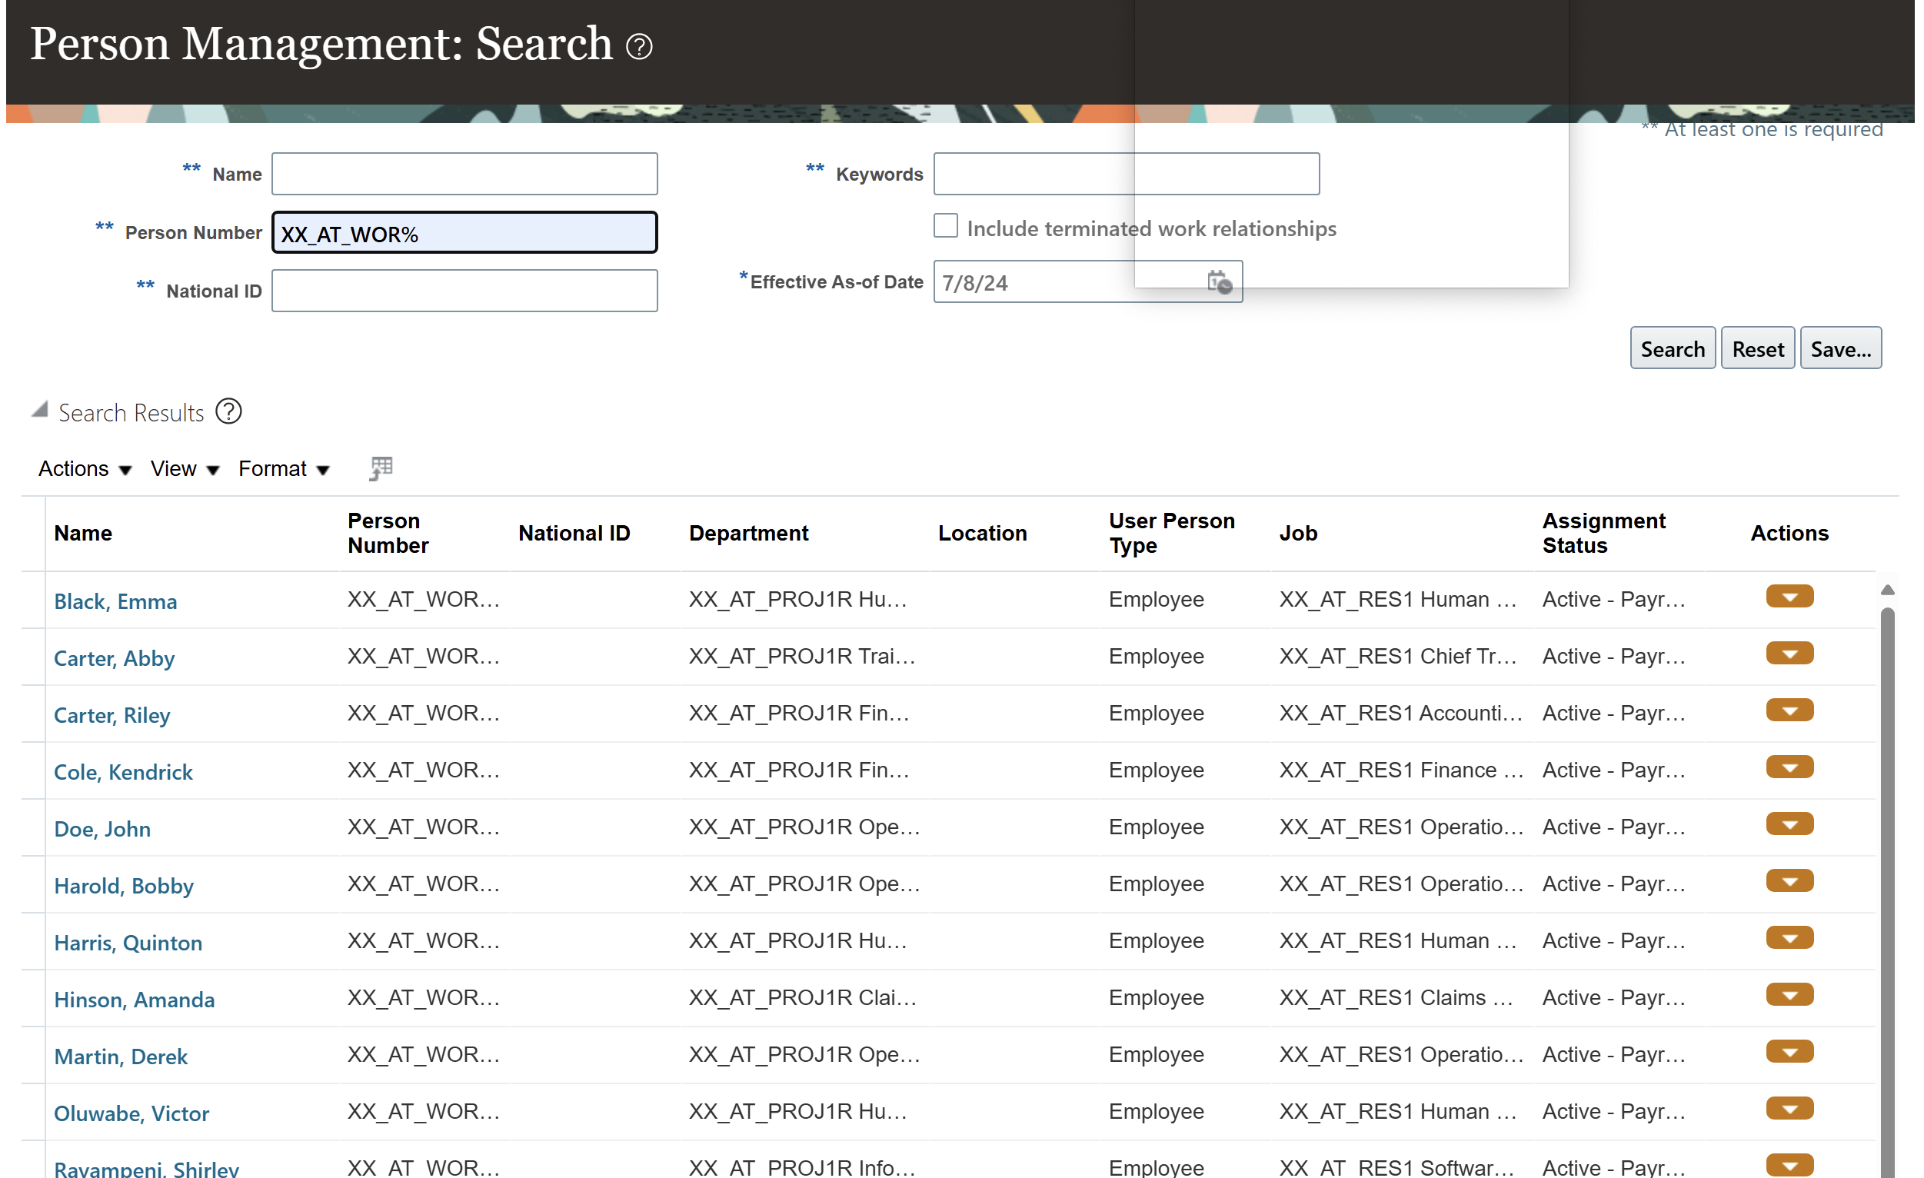
Step1: Populating the Organization
Fourth step: Creating users/workers
Organization would be nothing without employees of any level in the hierarchy
Workers w/o management = chaos among store based operations; no company standards being upheld
Management w/o workers = inefficiency in store operations due to lack of workforce to produce product and provide sales

Slide 9
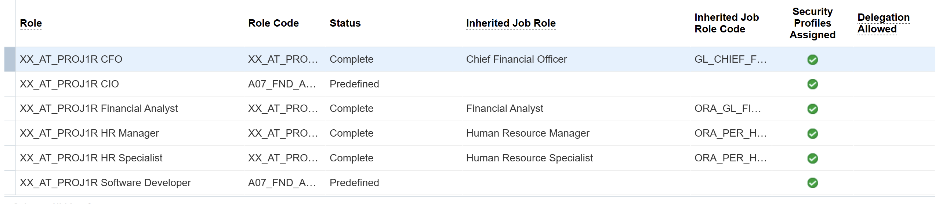
Step 2: Security Configuration
Role Based Access Control (RBAC) – Oracle’s method of accessing data and performing tasks
Roles need to be assigned to users to provide the ability to see features and perform tasks needed for their jobs

Slide 10
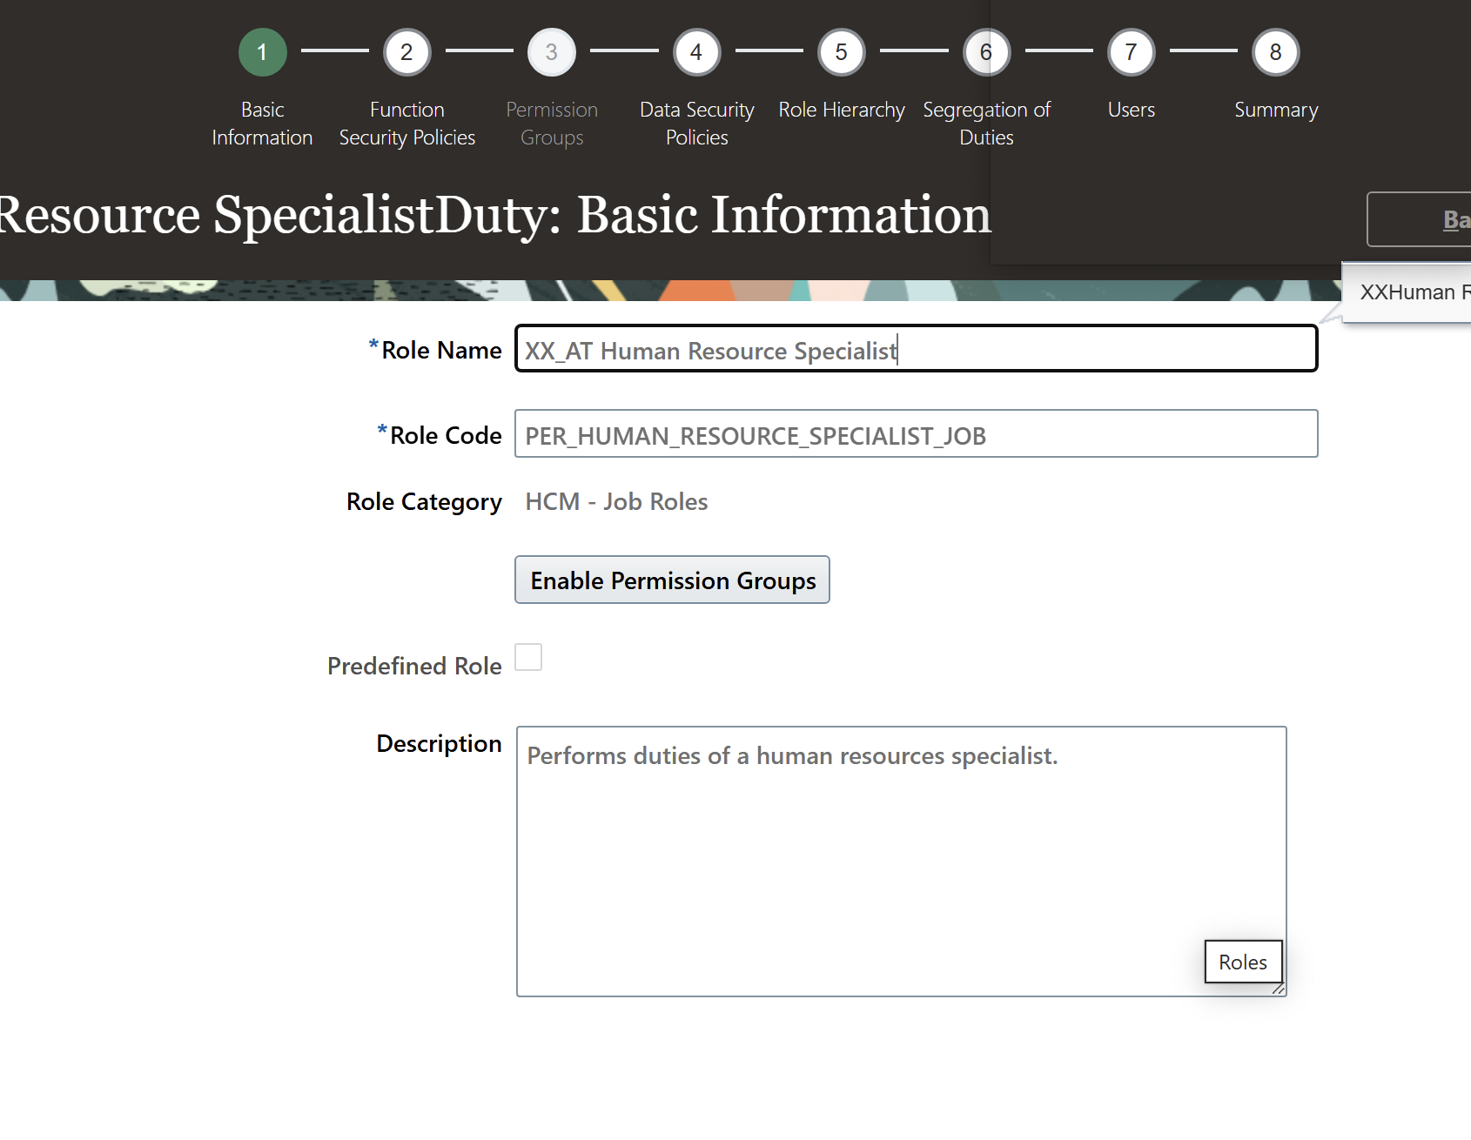
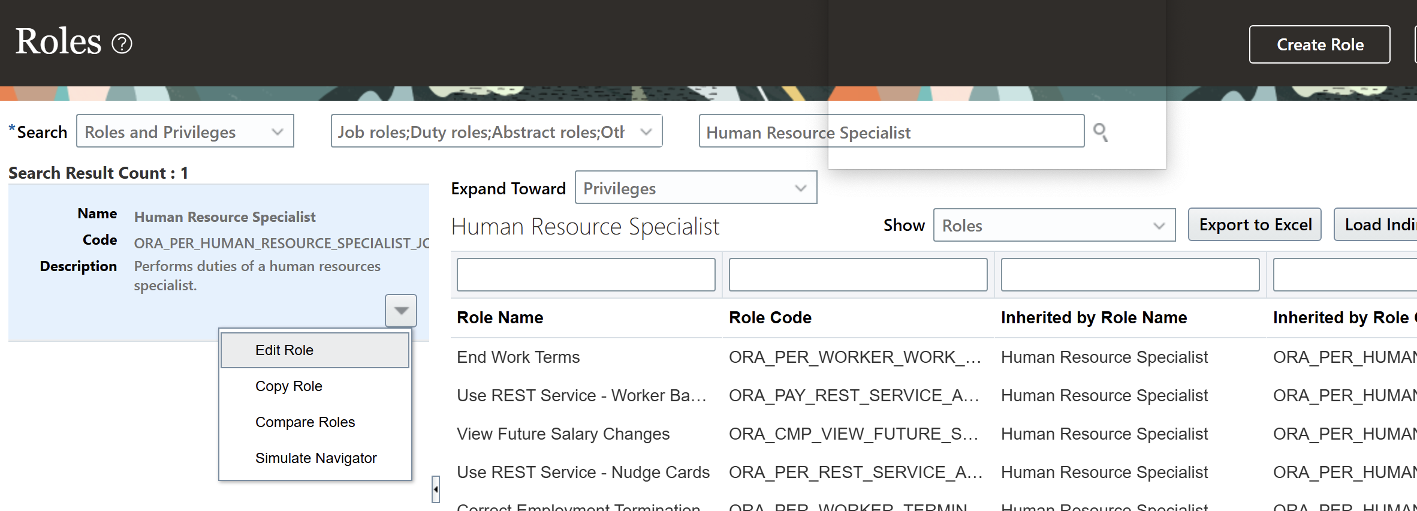
Step 2: Security Configuration
First a job role needs to be present. Can be created entirely from scratch or copied from an existing role (use copy of role)
When creating roles from an existing roles it’s important to use a copy of those roles instead of the actual role to prevent data loss

Slide 11
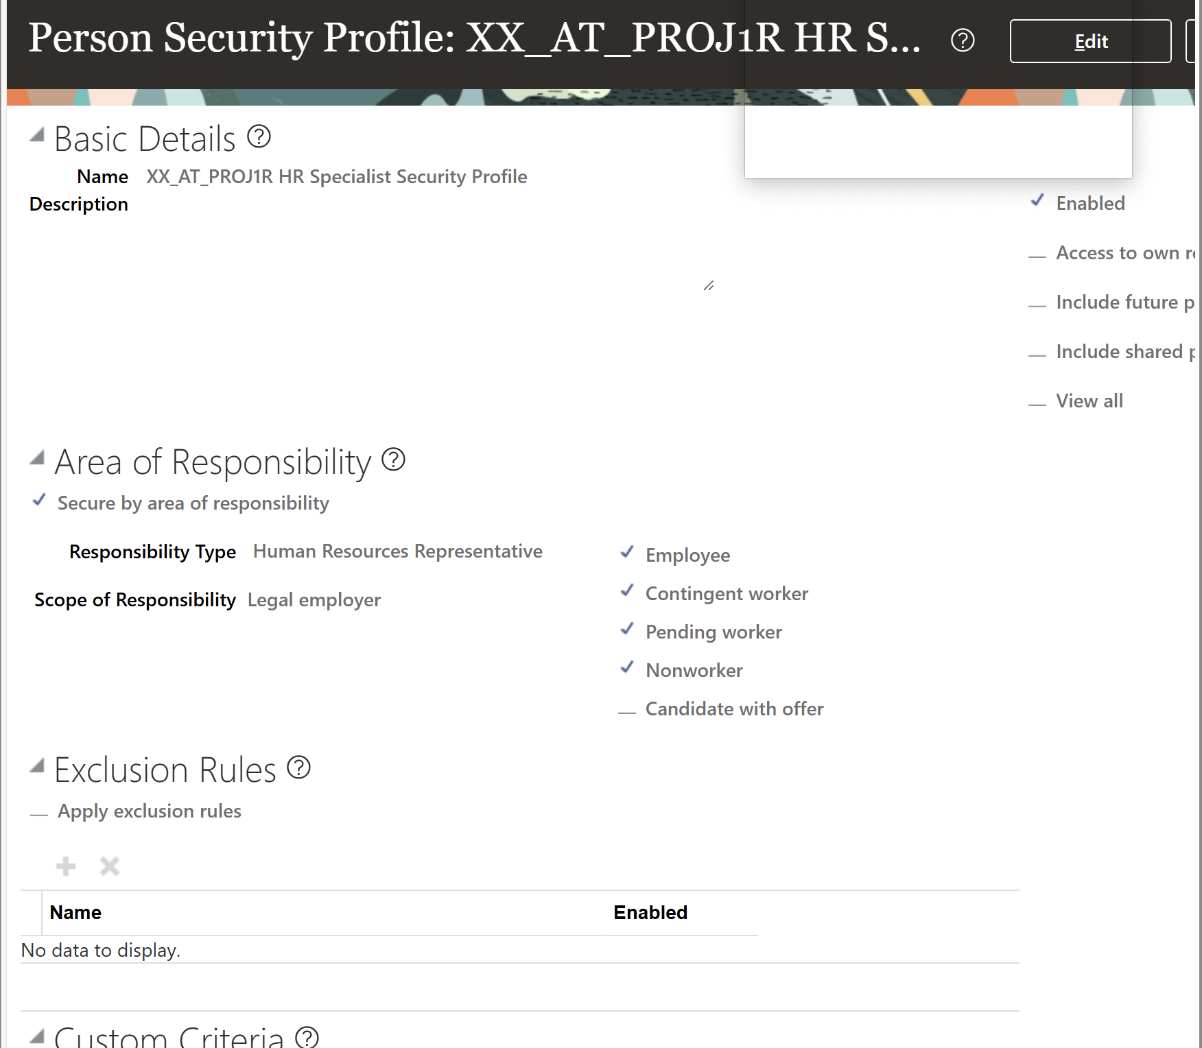
Step 2: Security Configuration
Next, a security profile needs to be added in order restrict access to data to certain people, positions, data groups, etc.
Information can be restricted based on several scopes such as legal employer, business unit, and legislative unit

Slide 12
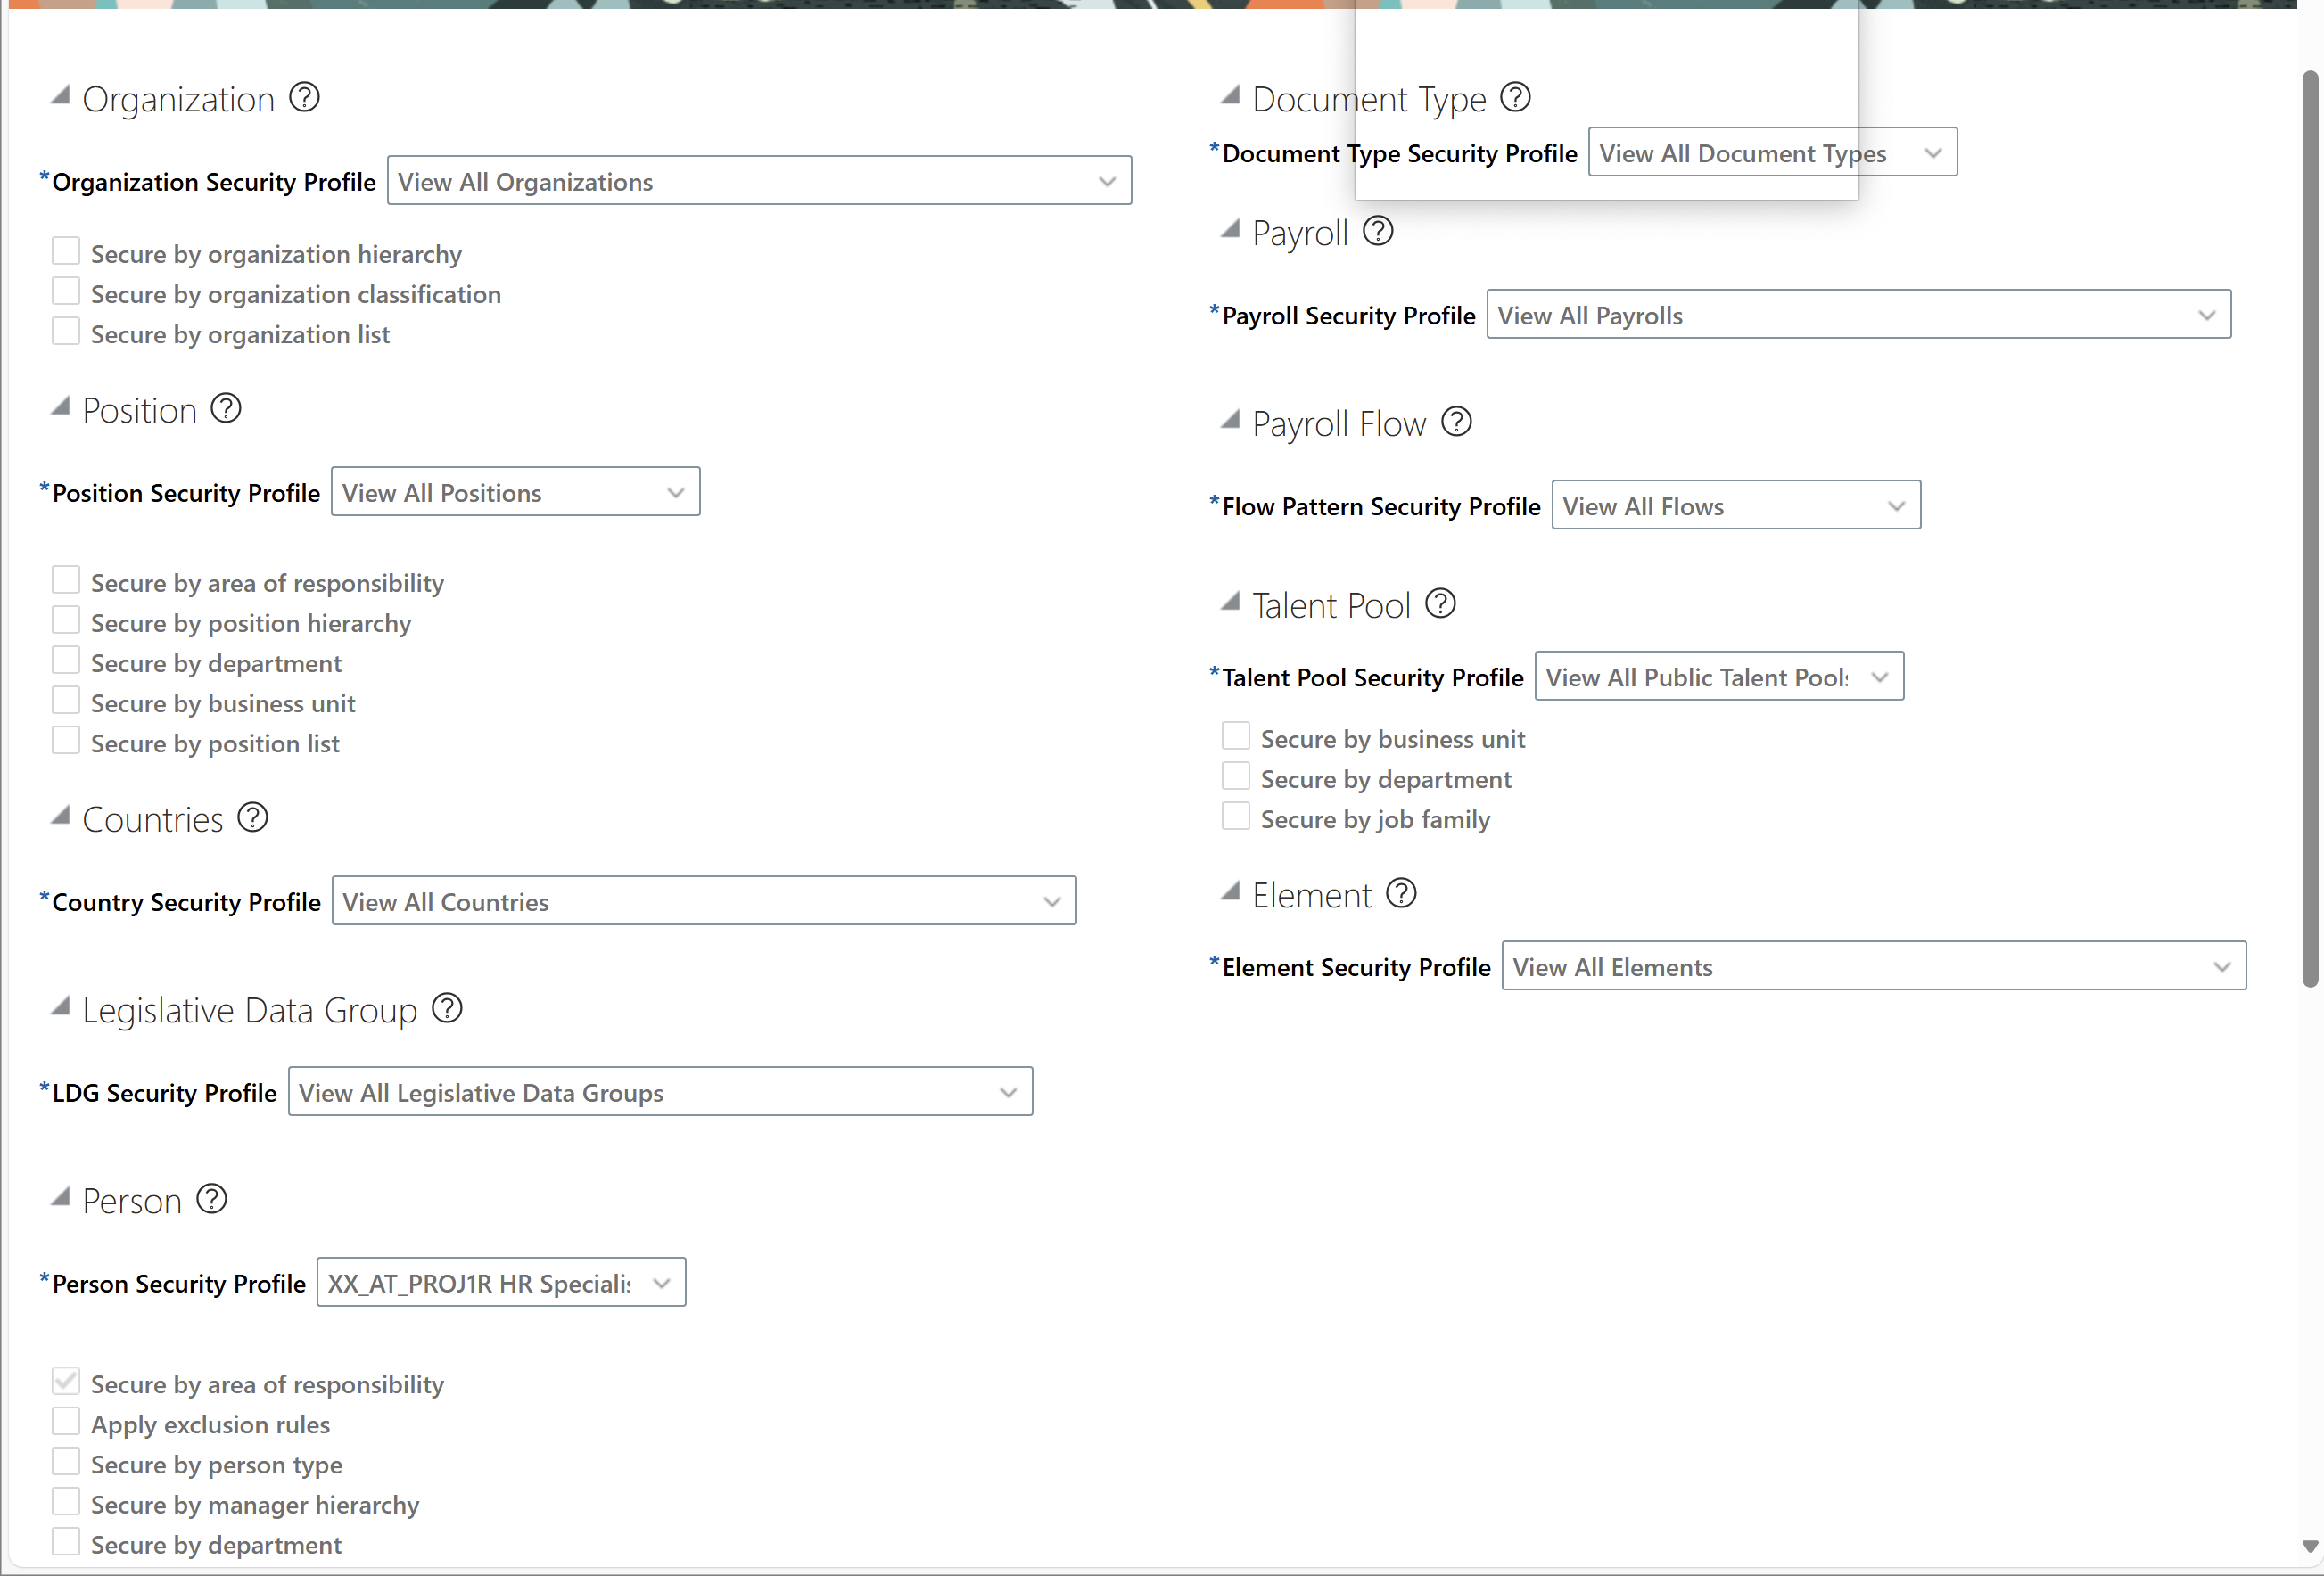
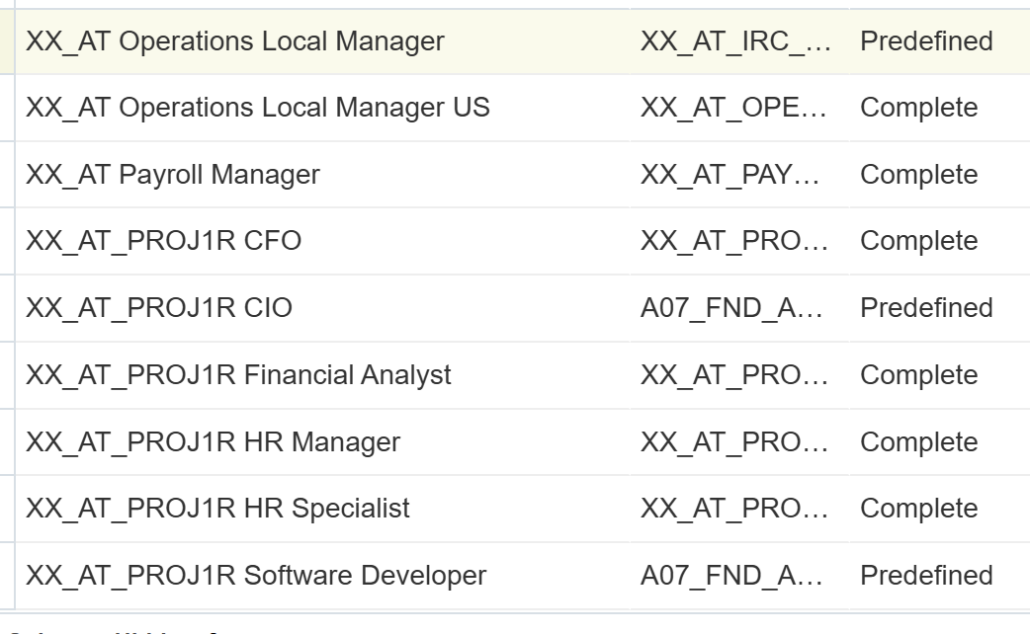
Step 2: Security Configuration
After, create a Data Role by assigning security profiles to the role in the Security Profiles Configuration section
Different types of profiles offers different restrictions (position profiles will restrict which positions can be viewed, etc.)

Slide 13
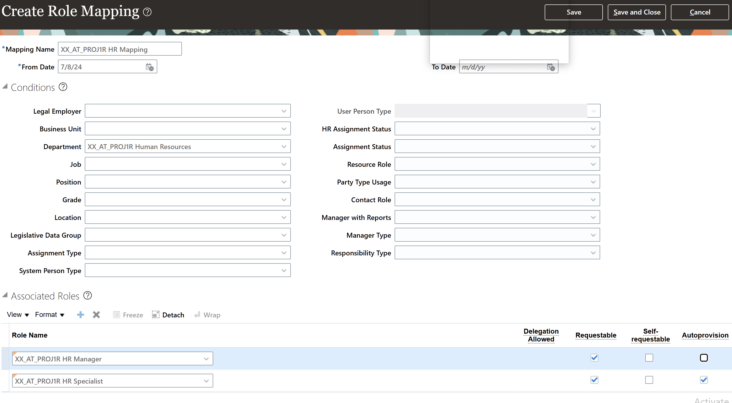
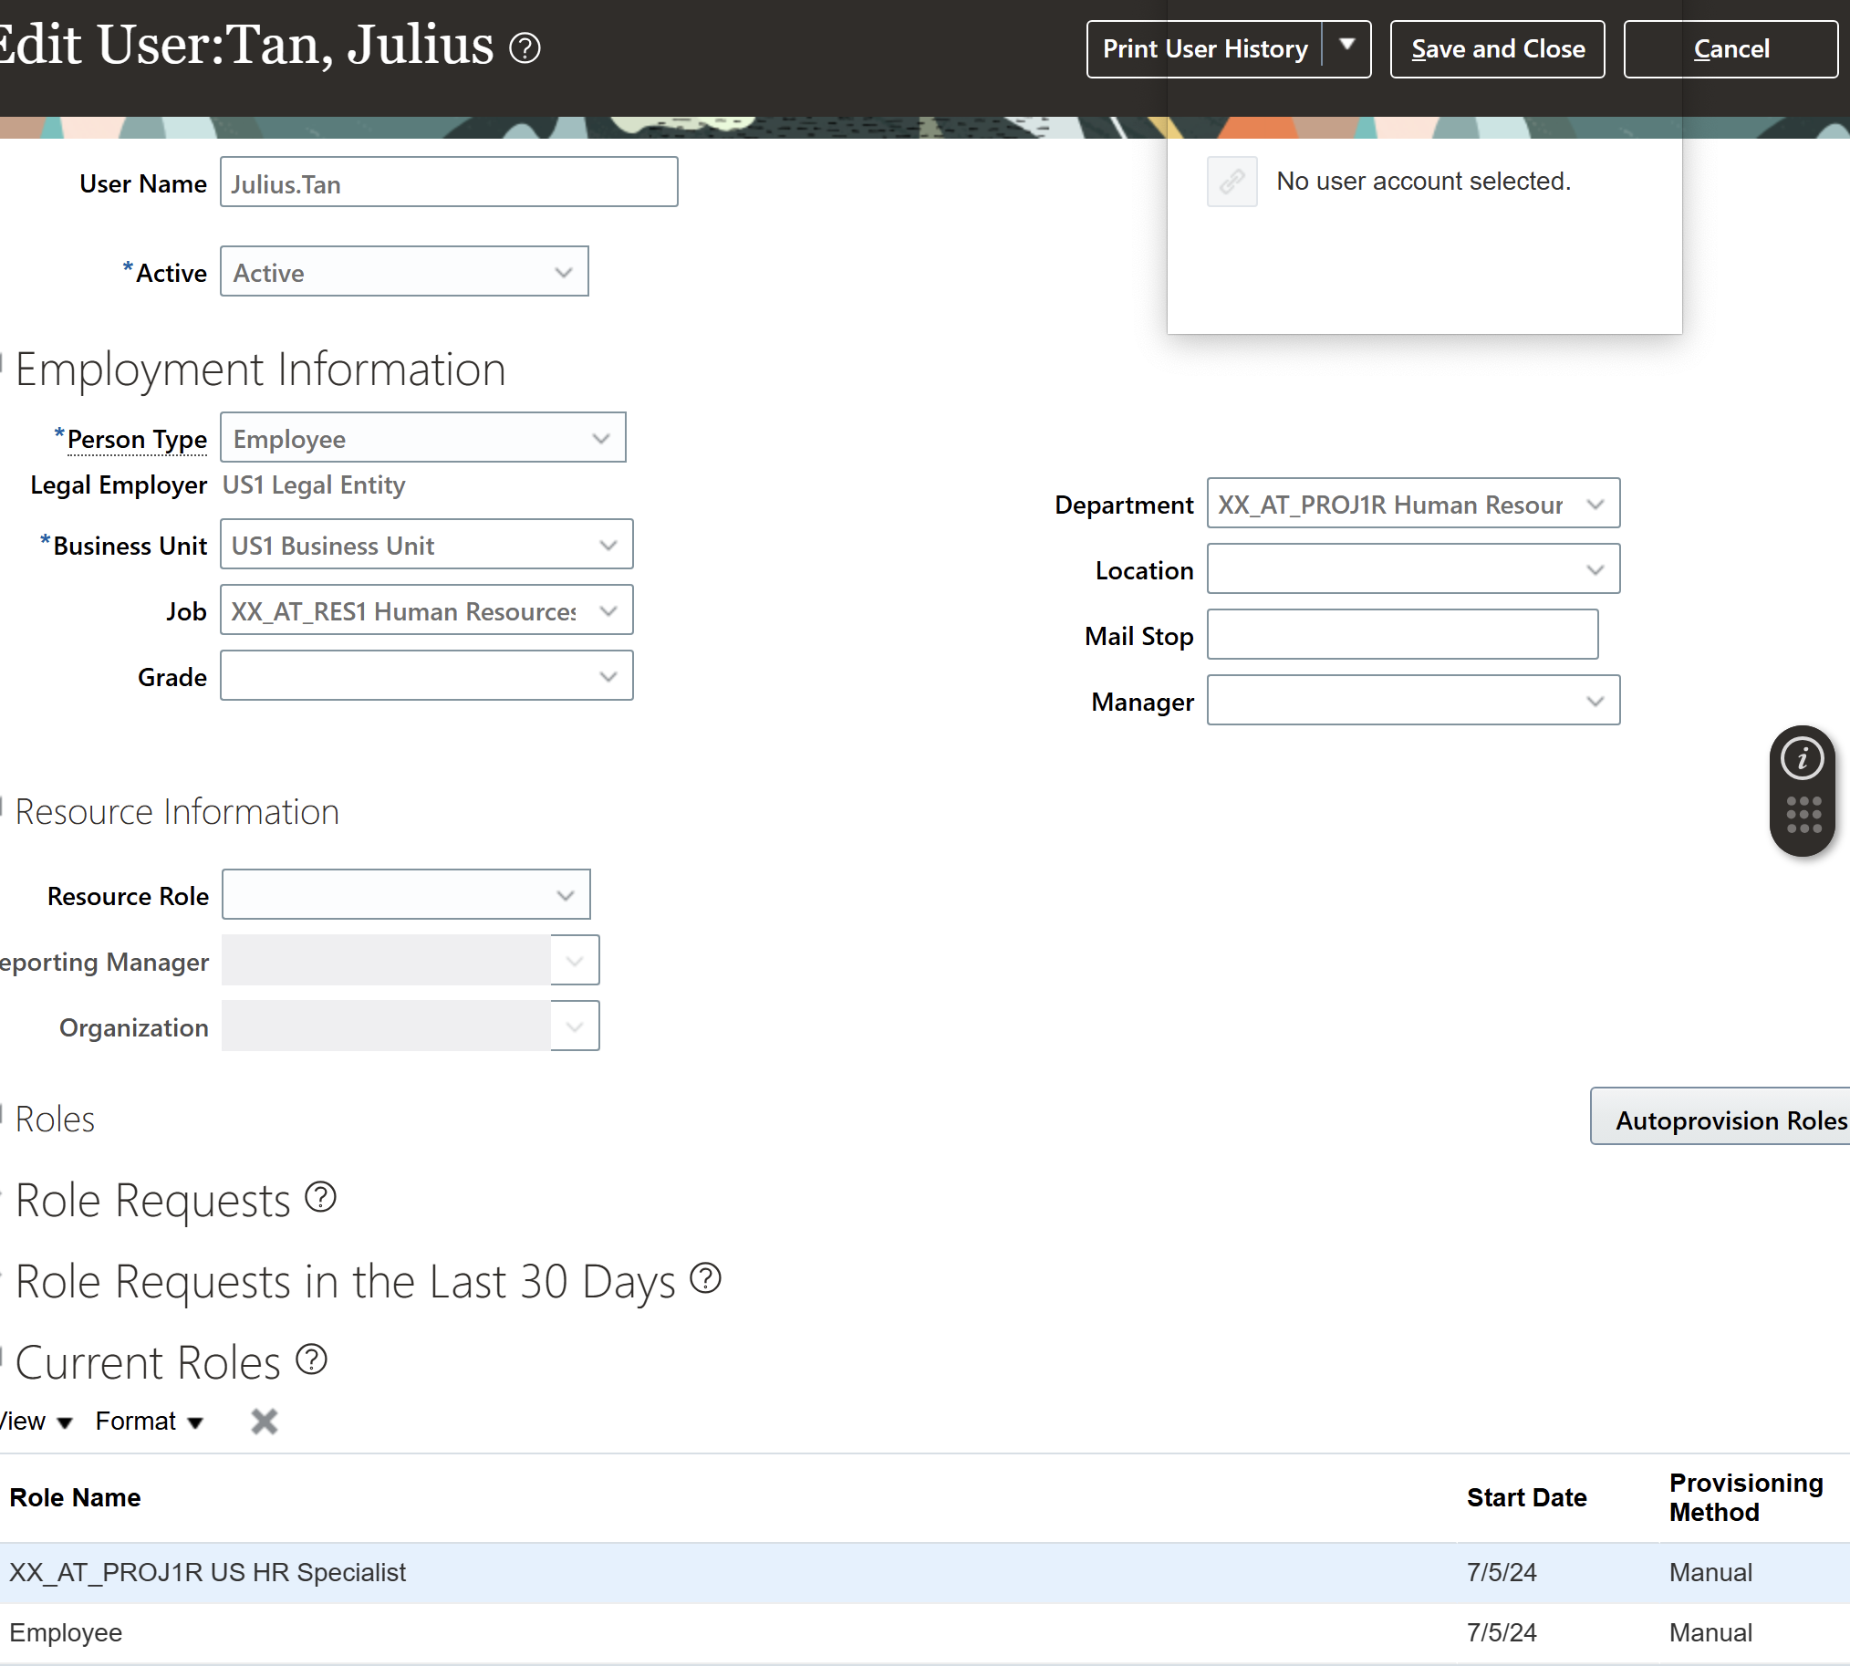
Step 2: Security Configuration
Finally, create a role provisioning(role mapping) for assignment to newly created user accounts.
Roles assigned to role mapping rules can be auto provisioned to users or can be requested(added) through search

